Slide 1
418536 Advanced Operating System Administration
Lecture 1

Slide 2
Outline
Administrivia
What’s a sysadmin?
Two non-technical issues I want to talk about.
Documentation
Ethics

Slide 3
What is this course about?
Being a system administration (sysadmin).
How to use Linux.

Slide 4
Goals
To let you know what it feels to be a sysadmin.
To give some tips on how to be a good one.
To teach you how to use Linux to do sysadmin tasks.
To practice your technical communication skills.

Slide 5
Disclaimer
I’m new.
I have not been a sysadmin.
I use Linux, but both my machines run Windows.
This course is new.
It’s not clear the direction I’m taking it is the best one.
Assignments and quizzes are not polished.
Syllabus will not be stable.

Slide 6
Implications
I need your feedback.
If you don’t like something, negotiate with me.

Slide 7
Grading
Four homework assignments (50%)
An unattended Ubuntu installation disk (10%)
Linux hands-on (10%)
A tutorial on how to use Linux program (10%)
A survey on your organization’s computer system (20%)

Slide 8
Grading (cont.)
Two quizzes (30%)
1.5 hours each
15% each
In class
Final exam (20%)

Slide 9
Instructor
Pramook Khungurn
Office Hours
Monday, Wednesday 10-12
In front of CS dept office.
Or by appointment.
pramook@gmail.com
Cell: 08-5453-5857

Slide 10
Textbook
Limoncelli, Hogan, and Chalup. The Practice of System and Network Administration
First edition is available in the deparment’s library.
Second edition is on its way here.
Also, the Internet.

Slide 11
Outline
Administrivia
What’s a sysadmin?
Two non-technical issues I want to talk about.
Documentation
Ethics

Slide 12
What’s a system adminstrator?
Someone who manages a system for someone else.
In our case, a computer system.

Slide 13
What do sysadmins do?
They install and maintain:
Workstations
Servers
Data Centers
Network
Services
Email, software depot, printing, data storage, backups
Web services.

Slide 14
What do sysadmins do? (cont.)
They deal with:
Outages and disaster recovery
Questions and problems form customers (aka troubleshooting)
Performance tuning

Slide 15
What do sysadmins do? (cont.)
They engineer:
How to organize a computer infrastructure
How a site would grow
Security policy

Slide 16
What do sysadmins do? (cont.)
They educate:
Customers
Technical support staffs

Slide 17
In short, sysadmins…
Keep things running.
Deal with changes.

Slide 18
What sysadmin don’t do
Develop new computer systems and software.

Slide 19
What do they matter?
People are more dependent on computer systems.
People have higher expections.
Technology keeps changing.

Slide 20
Outline
Administrivia
What’s a sysadmin?
Two non-technical issues I want to talk about.
Documentation
Ethics

Slide 21
What is Documentation?
Keep record of where things are.
Explain how to do things.
Make useful information available.

Slide 22
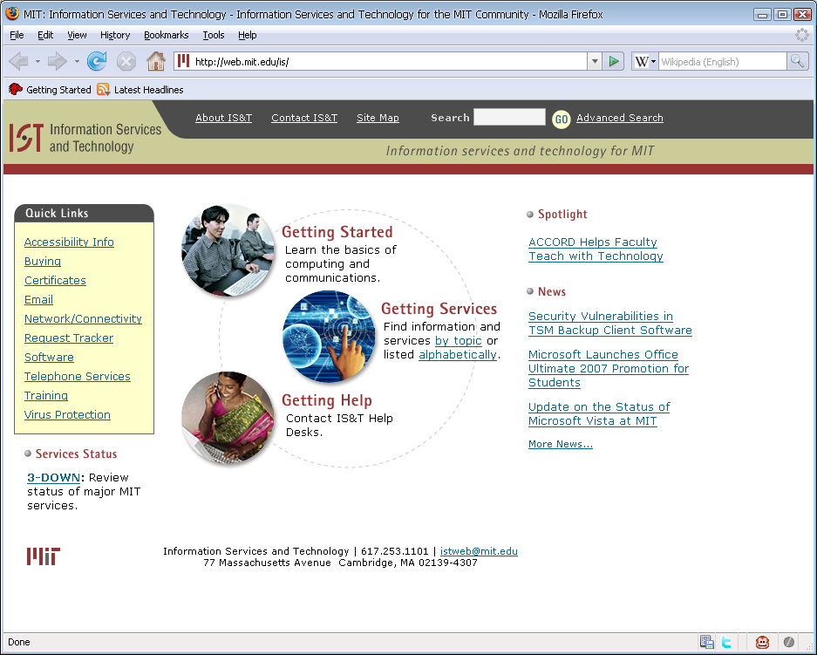

Slide 23
Why document?
Let you improve your team’s skills.
Prevent you from being trapped in your position.
Make your job easier
Free up mental space.

Slide 24
Common Types of Documentation
HOWTOs
FAQs
Reference Lists
Procedures
Checklists

Slide 25
HOWTOs
Environment specific.
Oriented to achieving some particular goals.
Solve a particular problem rather than teach a concept.

Slide 27
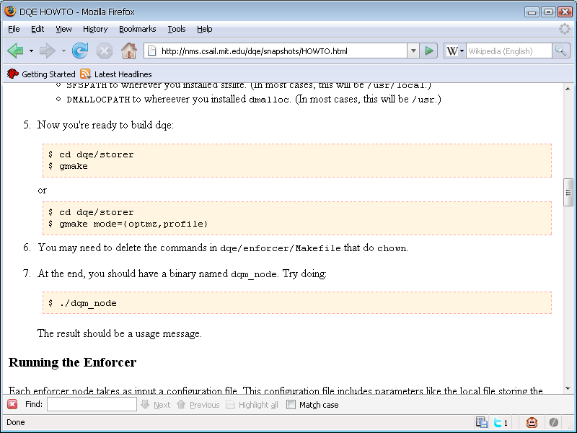

Slide 28
Common Types of Documentation
Frequently Asked Questions (FAQ)
A list of questions that get asked over and over again (with answers)!
Can be convenient.
Can be hard to navigate.
Evolve over time.

Slide 29
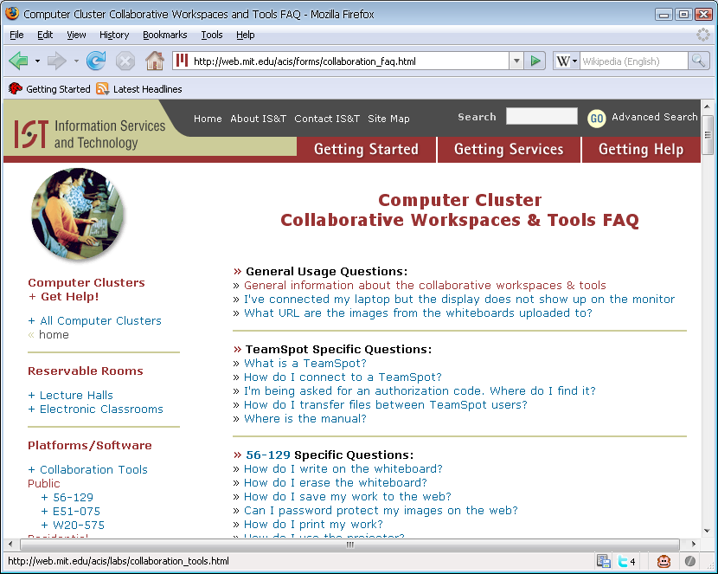

Slide 30
Reference Lists
Not accessed very often.
Serve a specific purpose.
Examples
Vendors and their contact info
License keys and number of software uses
Employee directory

Slide 31
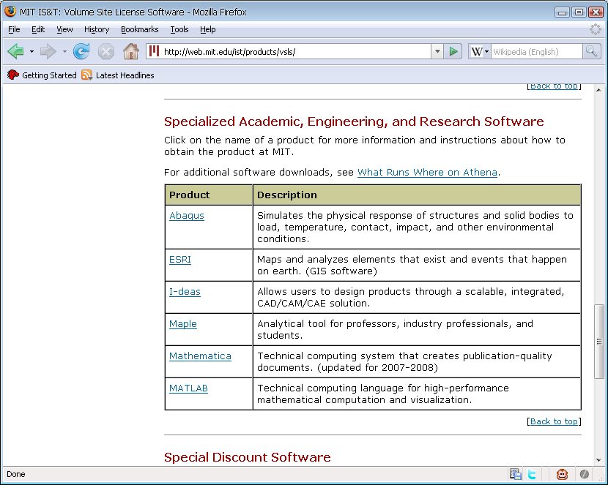

Slide 32
Procedures
Useful when your organization is under ISO or other standards.
Useful also when dealing with law enforcements.

Slide 33
Checklists
Each line or paragraph contains only one step.
Why?
Reduce mistakes
Improve accountability.
Examples
Task to be done for each new hire.
Task to be done for employee termination.
Installation tasks.
How to archive data:
Off-site storage.
When data is required by law enforcement.
How to secure an OS before deploying.

Slide 34
Tutorial
Teach a concept.
Cursory.
Useful for getting familiar with something.
You’ll write one this semester.

Slide 36
Principles
Be selfish.
Use documentation to make your job easier.
For examples:
Questions you are asked over and over.
Tasks that you don't like to do.
Things that only you can do.
Mistakes you have to fix.

Slide 37
Things to Document
It should be:
Complicated
Unpleasant
The above criteria apply to both:
The process itself
Its consequences
Examples
Setting up a new employee’s account.
Process that has a lot of steps, and ordering matters.

Slide 38
Template
Title
Metadata
Author
Contact Information
Revision date
History
What
A sentence or two describing the content.
How
The steps to accomplish the goal.
You may also add a “why” for a step that seems complicated.

Slide 39
Documentation QA
Check for
Typos
Skipped steps
Have someone follow the instruction, and see if it works.
Create a “quick guide” once you know it works.

Slide 40
Gathering Materials
Saving screenshots
Capturing command lines
Emails
Ticket system

Slide 41
Saving Screenshots

Slide 42
Capturing Command Lines
“script” command
“history” command

Slide 43
Document Repositories
A directory on a shared server
Items are text files.
Intuitive subdirectory structures.
May add source control.

Slide 44
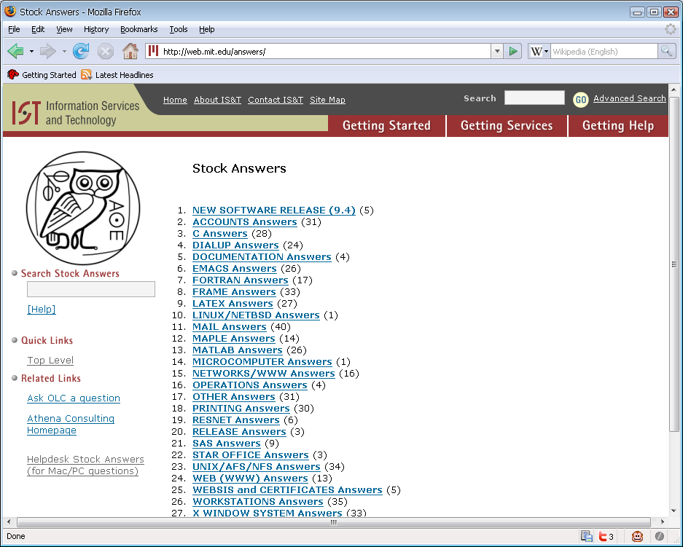

Slide 45
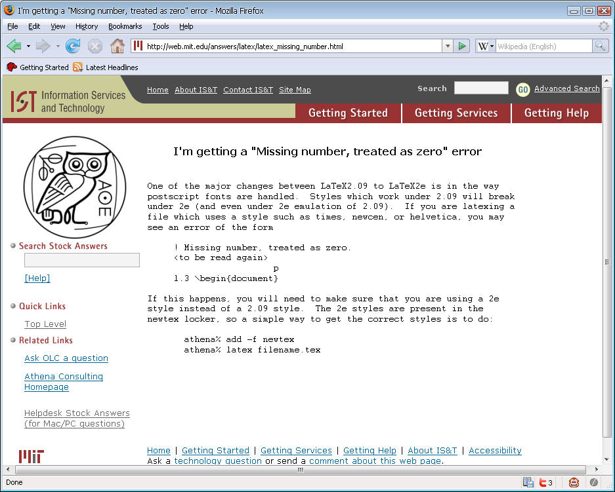

Slide 46
Wiki
Web-based publishing tool that everything can edit.
Low “barrier of entry.”
Low maintenance cost and effort.
Can create placeholders and fill as you go.
http://www.wikimatrix.org

Slide 47
Getting “Buy-Ins”
Have more than one way to access it.
RSS Feed
“Update” emails
“Recent changes” section
If someone manages the repository,
“Enabler” rather than “gatekeeper”
Only move. Don’t delete.
Don’t worry about structure on the outset.

Slide 48
Getting “Buy-Ins” (cont.)
Develop a “culture of respect.”
Don't feel the need to be “approved.”
Don't hesitate to edit other people's work.
Have a comment page that anyone can edit.
Different organizations, different cultures.

Slide 49
External Links
The IntraWeb is your friend.
Tutorials
Blog posts
Wikipedia
Use anonymizing redirection service.
You can unknowingly reveal your company secrets!
Privacy!

