Slide 1
Stupid Spherical Harmonics (SH) Tricks
Peter-Pike Sloan
Microsoft Corporation

Slide 2
What’s not in this talk?
Whitepaper has details:
www.ppsloan.org/publications/StupidSH35.pdf
Will update a bit after GDC as well
Great visuals
Lots of pictures of spheres + spherical functions…
other talks…

Slide 3
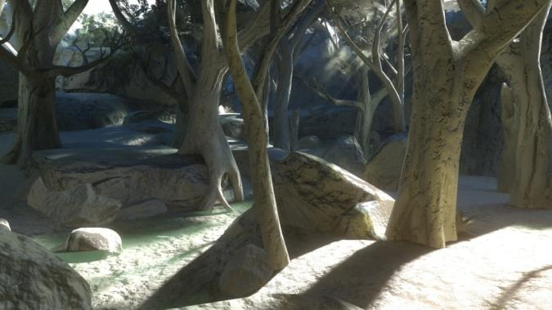
SH at GDC 2008
Thursday 4-5pm, 2004 West Hall
Lighting and Material of HALO 3
Hao Chen (Bungie)
Friday 2:30-2:50pm, 3004 West Hall
Lightmap Compression in HALO 3
Yaohua Hu (Bungie)
Monday Room 2018
Practical Methods for PRT using SH
Manchor Ko (Naughty Dog)
Notes:
I’m not going to have any great looking screen shots, but there are talks tomorrow and Friday from Bungie and one on Monday from Manchor Ko that have much better looking content.

Slide 4
Talk Overview
Overview/Background SH
Representing/Extracting lighting models
“Ringing” and what to do about it
SH Products, what they are and how they can be used
Notes:
I will first give an overview of Spherical Harmonics and discuss how they’ve been used.
Then I will talk about how to represent light sources using SH, and pull analytic models out of SH.
Ringing is an artifact that can happen when using SH I’ll describe why it happens and what you can do about it.
Finally I’ll talk about SH products and how they can be used.

Slide 5
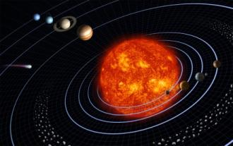
Harmonic Functions?
Solutions of Laplaces equation
Divergence of gradient = 0
Potential theory: fluids, e&m, gravity
Fourier basis is solution on unit circle
Spherical Harmonics are solution on the sphere
Also eigenfunctions of Angular Momentum operators in Quantum Chemistry/Physics
Notes:
The first question to be asked is, what are harmonic functions? They are the solutions of laplaces equation equal to zero.
Laplaces equation, the divergence of the gradient of a scalar function, which in cartesian coordinates is simply a sum of the un-mixed second partial derivatives.
Functions with zero laplacians are the subject of potential theory – in fluid simulations zero laplacian means irrotational and uncompressible flows, the study of electric and magnetic fields (of the earth for example) and gravity also use this constraint.
For a circle, the solution is the Fourier basis.
The spherical harmonics are the solution on the sphere (and also the angular portion of the solution expressed in spherical coordinates.)
In Quantum Chemistry/Physics SH are the eigenfunctions of the Angular Momentum operator, this and geomathematics are probably the most frequent references in the literature.
For this talk, these properties aren’t really important though. We are primarily going to just use them to represent spherical functions.

Slide 6
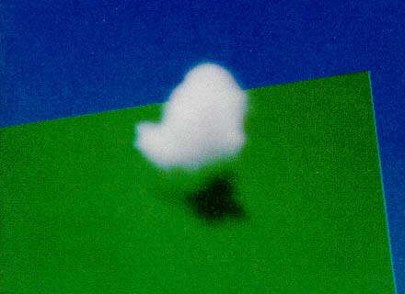
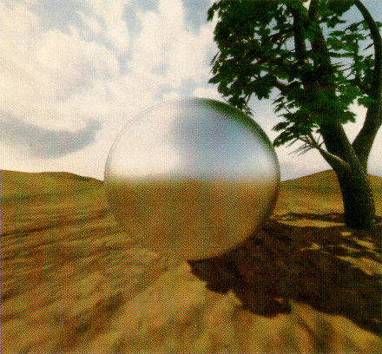
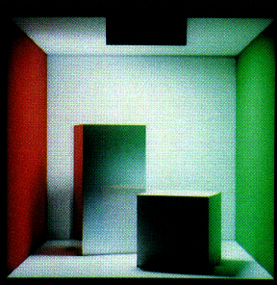
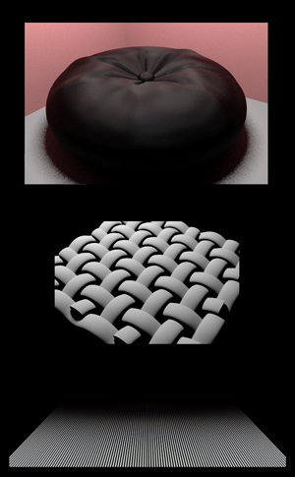
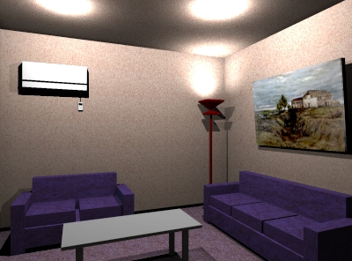
SH for Graphics?
[Kajiya84]
[Cabral87]
[Sillion91]
[Dobashi95]
[Stam95]
[Westin92]
Notes:
Spherical harmonics have been used quite a bit in graphics. The first paper I am aware of is by Kajiya and Von Herzen (sp?), and it uses them to model the scattering phenomena in things like clouds. The next paper I know about was by Cabral and colleagues, there they are used to represent reflectance properties of a micro-face surface and the lighting environment, to model un-shadowed glossy reflections.
They have also been used for off-line global illumination algorithms to model directional radiance for glossy GI, to model sampled reflectance models (a pair of them used to model incoming and outgoing hemispheres), to model the directional distribution of light from a fixed light source for lighting design – this is the first interactive application I know of that used SH, and again for scattering phenomena like clouds.

Slide 7
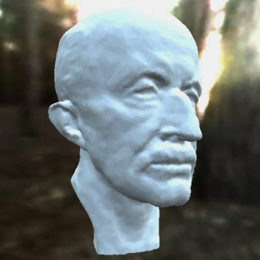
SH for Interactive Graphics
[Ramamoorthi01]
Irradiance Environment Maps
Reflected light for diffuse objects
Notes:
Ravi had a paper in Siggraph 2001 that used SH to model irradiance environment maps – this renders diffuse objects from distant illumination efficiently.

Slide 8
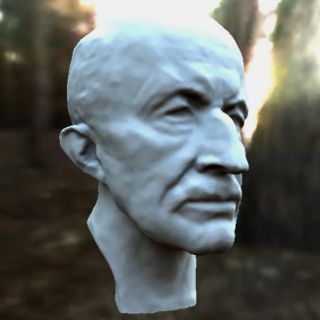
SH for Interactive Graphics
[Ramamoorthi01]
[Sloan02]
Precompued Radiance Transfer (PRT)
Models shadowing, inter-reflections
limited glossy surfaces
Irradiance Environment Maps
Reflected light for diffuse objects
Notes:
We had a paper in siggraph the following year, that represented the lighting using SH, and precomputed “transfer functions” over an objects surface, enabling interactive rendering of complex global illuminations effects like soft shadows, and inter-reflections.
Much of the work using SH at some level is a derivative of one of these ideas.

Slide 9
SH for Interactive Graphics
[Ramamoorthi01]
[Sloan02]

Slide 10
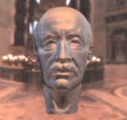
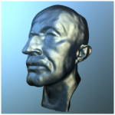
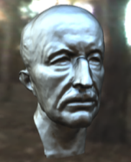
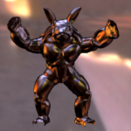
SH for Interactive Graphics
[Kautz02]
[Lehtinen03]
[Sloan03]
General BRDF’s
[Ramamoorthi02]
Unshadowed
[Ramamoorthi01]
[Sloan02]
Notes:
Ravi’s work was extended to handle reflection from a restricted model of surface reflectance (not just SH), and our work was extended to handle a wide range of reflectance properties, add sub-surface scattering to the effects that can be modeled and compress the results to make them more practical.

Slide 11
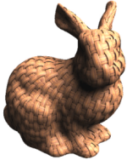
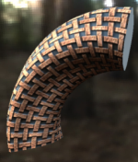
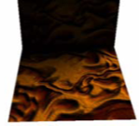
SH for Interactive Graphics
[Kautz02]
[Lehtinen03]
[Sloan03]
General BRDF’s
[Ramamoorthi02]
Unshadowed
[Ramamoorthi01]
[Sloan02]
[Sloan03]
[Sloan05]
[Sloan06]
Texture Details
Notes:
PRT has also been extended to model texture details and normal maps.

Slide 12
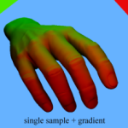
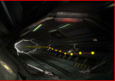
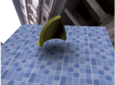
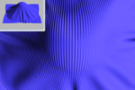
SH for Interactive Graphics
[Kautz02]
[Lehtinen03]
[Sloan03]
General BRDF’s
[Ramamoorthi02]
Unshadowed
[Ramamoorthi01]
[Sloan02]
[Sloan03]
[Sloan05]
[Sloan06]
Texture Details
[Annen04]
[Oat05]
[Sun05]
[Habel08]
[Wang07]
[Han07]
[Green07]
Notes:
Other uses of SH that don’t fall into either category include modeling SH gradients, enabling non-distant lighting environments to be used, using SH gradients to tie the lighting of a character (ruby) in demo to the GI lighting in a scene, SH have been used modeling more complex scattering models for homogenous fog, using SH just for visiblity to modulate unshadowed glossy reflections, “spherical harmonic scaling” builds operators on SH that scale around a given direction, which can be used to model dynamic cast shadows.
A paper I just found out about a couple of weeks ago takes the preetham skylight model and projects it into SH.

Slide 13
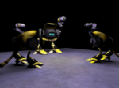
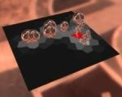
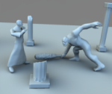
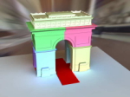
SH for Interactive Graphics
[Kautz02]
[Lehtinen03]
[Sloan03]
General BRDF’s
[Ramamoorthi02]
Unshadowed
[Ramamoorthi01]
[Sloan02]
[Sloan03]
[Sloan05]
[Sloan06]
Texture Details
[Annen04]
[Oat05]
[Sun05]
[Habel08]
[Zhou05]
[Ren06]
[Sloan07]
[Pan07]
[Wang07]
[Han07]
Dynamic Scenes
[Green07]
Notes:
More recent work doesn’t involve precomputation, and uses SH to model shadows and now inter-reflections of dynamic scenes.

Slide 14
What aren’t SH good for?
High frequency signals
Global support
Some other basis functions can be better
Notes:
While SH are useful, there are scenarios where other basis functions are more appropriate. High frequency signals are inefficiently represented using SH – they have global support and get expensive as you increase the number of terms.
Other basis functions can be better – particularly for things like hemispherical functions. There are some important properties SH has that these other basis functions don’t.

Slide 15
Conventions
Functions
Coefficients
Bold for column vector
BOLD for matrix
Notes:
Here are the notational conventions I will try and use during this talk:
Lower case italic letter with a parameter represents a function, generally over the unit sphere (s denotes a point on the sphere)
With the function parameter a lower case letter with a subscript represents a coefficient.
Bold lower case letters represent column vectors – this can be column vectors of functions.
A bold upercase letter represents a matrix.

Slide 16
Spherical Harmonics
Notes:
Here we see the first 3 bands visualized by distorting a unit sphere. Each point is scaled based on the magnitude of the basis function and colored based on the sign (red positive, blue negative.) Each row is a band, and columns are for basis functions in a band.

Slide 17
Spherical Harmonics
L is band, m is function in band (-L..L)
Notes:
The lower index of a basis function represents the band, the upper index a basis function in a band.

Slide 18
Spherical Harmonics
Band L has (2*L+1) functions
Order N: bands through N-1, N² functions
Notes:
Each band has 2l+1 basis functions and the SH through order N consists of all the bands through N-1 and consists of N^2 functions.

Slide 19
Spherical Harmonics
Notes:
The basis functions can be represented in spherical coordinates (shown here.) This is the most common definition shown in text books/the web, and is extremely useful when doing symbolic computations, but not so useful when writing code/shaders.

Slide 20
Spherical Harmonics
Notes:
In Cartesian coordinates the basis functions are simply polynomials. Shader and CPU evaluation code tends to use this representation.

Slide 21
Zonal Harmonics
Notes:
We’re going to make use of a subset of the spherical harmonics called “zonal harmonics”, shown here in the center column.
Zonal harmonics have only 1 basis function per band, and represent polynomials in Z.
Any function that has circular symmetry around the Z axis when projected into SH only has non-zero coefficients corresponding to the zonal harmonics.

Slide 22
Properties of SH
Single index
Reconstruction
Orthonormal basis
Projection is integration
Integral of product
Notes:
Some times we’ll use a single index to represent SH basis functions.
A function is approximated in SH using a set of coefficients, and is reconstructed by summing the basis functions times these coefficients. This can be expressed in vector notation as a dot product the coefficient vector and the vector of basis functions.
SH form an orthonormal basis. This means that the integral over th sphere of the product of two basis functions is zero unless the functions are the same, in which case it is 1.
Orthonormal basis have two important properties.
Projecting a signal into the basis (in a least squares sense) is done by simply integrating the function against the basis functions.
Also the integral of the product of two functions represented using an orthonormal basis is simply the dot product of their coefficient vectors.

Slide 23
Projection
…
Notes:
Here are images projecting a light probe (cube map on lower right) into progressively higher bands – DC through 6th order. Clear at these low orders you get a very blurring image of the lighting environment.

Slide 24
Projection
We evaluate integrals of lighting*BRDF (smooth)
…
Notes:
Fortunately in graphics we don’t point evaluate spherical functions that often, in general you integrate them against a moderately smooth function.

Slide 25
Projecton/BF demo
Notes:
Here is a demo that lets you visualize SH projections. This is a sphere illuminated by a light probe.
We can visualize the signal as a distorted sphere [‘B’] and change the order of the reconstruction [F11]/[F12]
We can also just plot the magnitudes on a sphere, red is positive blue is negative.
It is also possible to visualize the basis functions [F6] As you increase the order they get more “oscillations” and can represent higher frequency signals. I find both views useful [F5], for example in this lighting environment in the “distorted sphere view” the negative values have small magnitude so aren’t terribly obvious, but in the sphere view [B] they are more apparent.

Slide 26
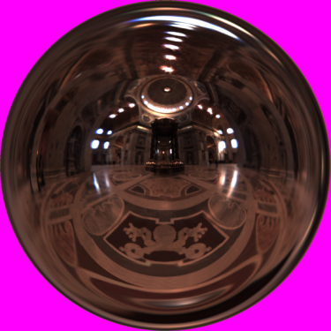
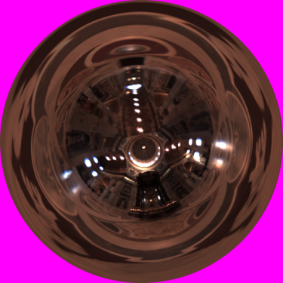
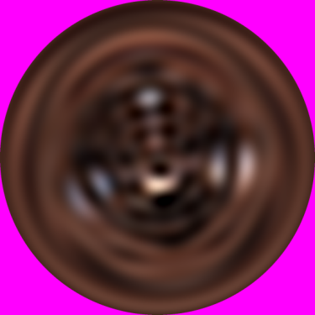
SH Rotational Invariance
rotate
SH
SH
rotate
Notes:
One advantage of using the SH lighting basis is its rotational invariance property.
If you take a lighting environment and project it into low-frequency SH, you get a low frequency approximation. Rotating, which can be done in closed form with SH, we get this result.
This is the same result you get if you rotate the original, high frequency lighting environment and then project it using SH; in other words, the diagram commutes.
This means that lighting is stable under rotations, so you won’t get the temporal aliasing artifacts that you can get with other basis functions.

Slide 27
Rotational Invariance
Notes:
Here we see a comparison with a spherical radial basis function (ambient cube from HL2 – this has many nice properties, uses less memory and is cheaper to evaluate than SH), there are 6 of them centered on the 6 faces of the cube with a profile of cosine squared falling off to zero on the hemisphere. If the light is pointing right at the center of one of these basis functions it looks great, but if you rotate between them there is significant energy loss (using least squares projection – alternatively you would be gaining a lot of energy – particularly under the hemisphere), while SH is perfectly stable.

Slide 28
Rotation demo
Notes:
Here we see a sphere illuminated by a directional light source [D]. If I rotate the sphere the lighting stays the same [W] using the SH rotation formula. You can also look at the SH projection (just irradiance here) [B], [B], [2].
If I move to SRBF’s (Ambient cube) [H] – when the light source is pointing at some locations it looks great, but other locations a lot of energy is lost. Visualizing the irradiance function in this basis this becomes obvious [B][B][2].

Slide 29
SH Rotation Structure
O(n³)
Notes:
The structure of a spherical harmonic rotation matrix is fairly straightforward. Each band is rotationally independent, so the matrix is block diagonal.
Here we label the SH vector using the polynomial forms of its basis functions.
The DC term is unaffected by rotation, there is a 3x3 matrix for the linear basis functions, and a 5x5 matrix for the quadratic functions.
Because of its block diagonal structure, SH rotation is order n^3, where n is the SH order.

Slide 30
ZH Rotation Structure
O(n²)
Notes:
Zonal harmonic rotation is simpler than SH rotation, which is why we will make use of it extensively. There is only a single non-zero coefficient per band, so only a single column of the rotation matrix is applied.
Rotating ZH is thus order n^2.

Slide 31
What’s that column?
z
Rotate delta function δ so that z → z’ :
Evaluate delta function at z = (0,0,1)
Rotating scales column C by d_{l}
Equals y(z’) due to rotation invariance
z’
Notes:
What is the form of this ZH rotation column?
To derive it, consider rotating a delta function, circularly symmetric around Z, so that the Z axis rotates to a new axis Z’.
The delta functions are here visualized bandlimited to order 6. This is the “peakiest” signal we can get woth order 6 SH.
Integrating against the delta function simply evaluates the ZH basis functions at z, generating the constants d_l.
From the previous slide, rotating this delta function scales the central column C of each band’s rotation matrix by d_l.
But due to the rotational invariance of SH, this scaled column must equal projecting a delta function around the rotated axis Z’, which evaluates the SH basis functions at z’.
[click]
.

Slide 32
What’s that column?
z
Rotate delta function δ so that z → z’ :
Evaluate delta function at z = (0,0,1)
Rotating scales column C by d_{l}
Equals y(z’) due to rotation invariance
z’
Notes:
This tells us what the central column has to be

Slide 33
Efficient ZH Rotation
z
g(s)
Notes:
Now we can apply the rotation we just derived to an arbitrary circularly symmetric function about z, rather than a delta function.
We begin with a spherical function g(s) circularly symmetric about z.
[click]

Slide 34
Efficient ZH Rotation
z
g(s)
Notes:
We can find it’s zonal harmonic coefficients g_l using this integral, producing the numerical vector shown for this example.
[click]

Slide 35
Efficient ZH Rotation
z
z’
g’(s)
g(s)
Notes:
Now we rotate this function so that z goes to z’, resulting in function g’(s).
To find the SH coefficients of this rotated function,
[click]

Slide 36
Efficient ZH Rotation
z
z’
g’(s)
g(s)
Notes:
we evaluate the SH basis functions at z’ and scale the result by the diagonal matrix G*.
[cilck]

Slide 37
Efficient ZH Rotation
z
z’
g’(s)
g(s)
Notes:
Each component of the diagonal g*_l is just a scaled version of the original ZH coefficient g_l.

Slide 38
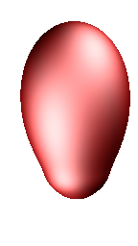
Convolution
h(z) (ZH) convolved with f(s) (SH)
Irradiance Environment Maps
h(z) is clamped cosine
f(s) is distant lighting
*
Notes:
Like the fourier transform, convolution is extremely simple. Any ZH function convolved with a spherical function results in a spherical function. ZH are the only functions that have this property – a general spherical function convolved with a spherical function generates a manifold in SO(2) (rotation group), it’s only circularly symmetric functions.
You simple scale all the basis functions in a band by the ZH coefficient times a constant (same one used to rotate the ZH.)

Slide 39
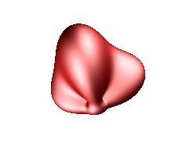
Convolution
h(z) (ZH) convolved with f(s) (SH)
Irradiance Environment Maps
h(z) is clamped cosine
f(s) is distant lighting
*
Notes:
Here we see the result of the convolution – at every point on the sphere we generate a new point by integrating the kernel oriented in that direction against the function f (blurring the function in this example.)

Slide 40
Convolution
h(z) (ZH) convolved with f(s) (SH)
Irradiance Environment Maps
h(z) is clamped cosine
f(s) is distant lighting
*
Notes:
Irradiance environment maps exploit this fact – the kernel is the clamped cosine function (shown later) and the function is a distant lighting environment. This kernel has the property that it is very low frequency, so only a small number of bands are needed.

Slide 41
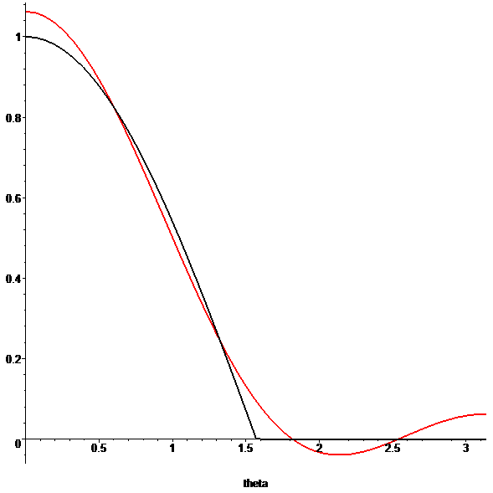
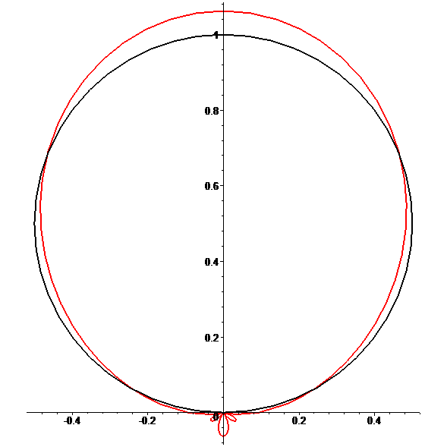
Irradiance Environment Maps
Notes:
Here we see the quadratic approximation of the clamped cosine function, on the left is a cross section (phi = 0, could be anything) plotted as a function of theta, on the right is a polar plot.
The black curve is the clamped cosine function, the red curve is the quadratic (order 3) SH approximation.

Slide 42
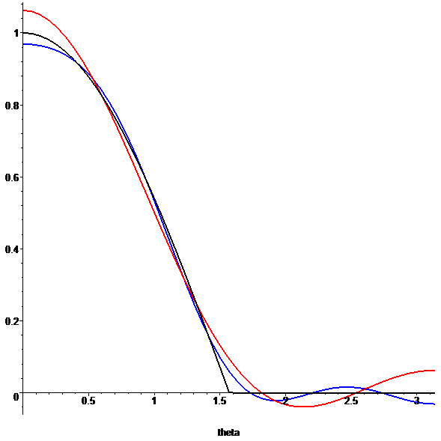
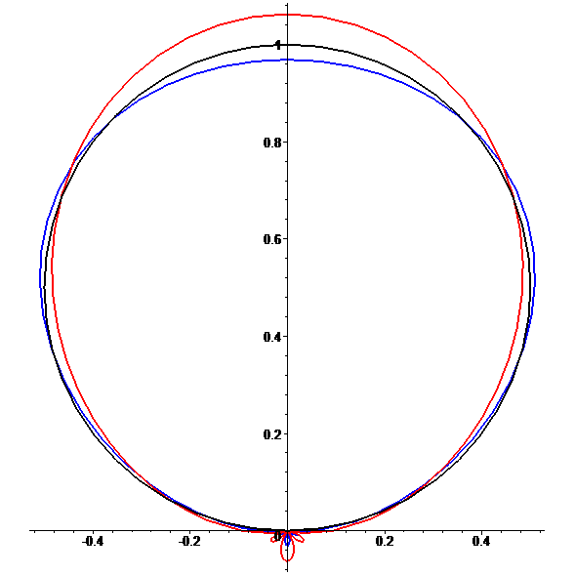
Irradiance Environment Maps
Notes:
Moving to order 5 (degree 4), you get the blue curve, which is a closer approximation but still has some error. In HDR lighting environments this can come into play.

Slide 43
Lighting

Slide 44
Projection into SH
Compute:
float f[],s[];
float fWtSum=0;
Foreach(cube map face)
Foreach(texel)
float fTmp = 1 + u^2+v^2;
float fWt = 4/(sqrt(fTmp)*fTmp);
EvalSHBasis(texel,s);
f += t(texel)*fWt*s; // vector
fWtSum += fWt;
f *= 4*Pi/fWtSum; // area of sphere
Notes:
One way to get light sources into SH is to simply use the projection formula on a texture. Here we show pseudo-code for a cube map.
You iterate over the faces of the cube map [click], at each texel [click] you have to compute the differential solid angle [click] – this represents the “area of the sphere” covered by a given texel and the equation depends on the parameterization. You then have to evaluate the SH basis functions for the direction on the sphere of the given texel [click].
[click] you simply accumulate this result.
[click] you could just divide by the total number of texels, but for small cube map resolutions this won’t quite equal the right value, so you might as well normalize the result.
Other parameterizations would simply use different differential solid angle equations.

Slide 45
Analytic Light Source
Directional light
Evaluate SH in direction
“Sphere” light source
Use ZH
Integrals closed form
“Cone” light source
Explicit θ
r
θ
d
P
Notes:
You don’t want to always blow things out through cube maps though. For analytic light sources there are simpler techniques.
Directional lights are the easiest, just evaluate the SH in the light direction.
Spherical light sources (shown here) can be done using ZH.
Using trigonometry it is easy to compute the spread angle of the light source.
If you align the direction from the reciever point to the center of the sphere with the Z axis, these integrals can be computed symbollicaly and are simple expressions of the sin and cos of this angle.
A “cone” light source can be modeld using the same ZH coefficients, the spread angle is just explicitly set instead of being infered from the sphere geometry and reciever position.

Slide 46
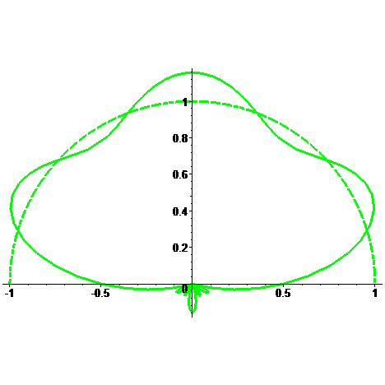
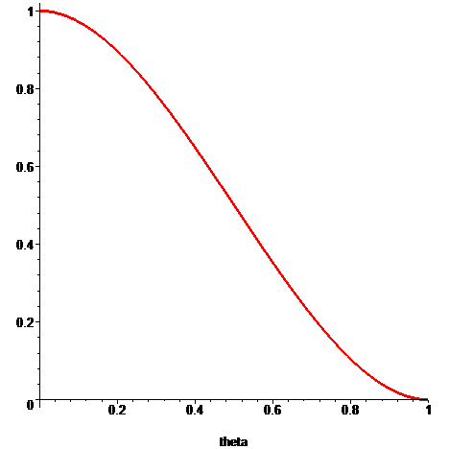
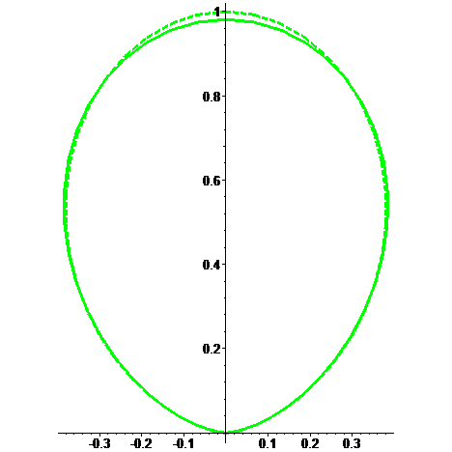
Analytic Light Source
“soft” cone
“ease spline” fall off
See whitepaper
Cone
Soft
Cone
Notes:
This cone light source can exhibit artifacts. Here we see the projection of a hemisphere on the upper right corner. Even at 6th order the approximation is farily wobbly.
A cone light source can be modeled that has a soft fall off over the spread angle. An ease spline is used (this is a common cubic polynomial used in animation, it is 1 at 0, and 0 at 1 with the derivatves zero at both end points. It is better behaved at large angles.

Slide 47
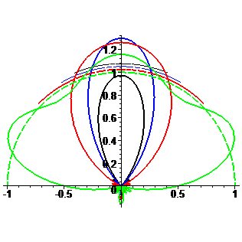
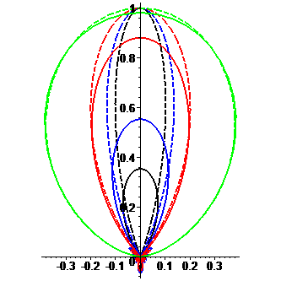
Analytic Light Source
“soft” cone
“ease spline” fall off
See whitepaper
Cone
Soft
Cone
Notes:
Here we see a set of projections of various size light sources.

Slide 48
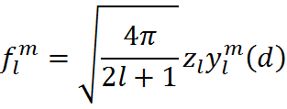
Practical Issues
Evaluation
Generate ZH vector from light parameters
Rotate to desired direction
Normalization
Reflected radiance for a normal pointing at light should be “a”
Notes:
Evaluating lights is simple. You evaluate the ZH coefficients as a function of the light parameters, and then rotate them to the correct orientation – which is just a SH evaluation and a per band scale.
If you are using [0,1] lighting, it is possible to “normalize” the lights, so that, for example, you can make the light reflected for an unshadowed normal pointing at the light source to be some constant. Doing this using the ZH vector for the clamped cosine function is easy, and compensates for projection error (which using an analytic normalization factor wouldn’t do.)

Slide 49
Light Demo
Notes:
Here we load the sphere scene again [Z][L]. This is illuminated with a directional light (smooth cone with a tight angle). As the spread angle is increased more of the sphere is lit. Looking at the SH projection [B], you can see that it is well behaved over all angles.
While a hard cone [G] gets a bit wonky as the cone angle gets large.
[C][L] you can see how the light source size changes the shadows more clearly when rendering a scene using PRT.

Slide 50
Extracting Lights from SH
Why?
Old (pre-shader) hardware
Glossy materials, conventional direct lighting
Compression
Single directional light
light reflected with normal N from directional light
light reflected with normal N from lighting environment
Notes:
Now that we’ve described how to throw light sources into SH, we’re going t talk about how to pull them out.
There are a couple of reasons this is interesting:
On older hardware you might not even be able to use irradiance environment maps, you can solve for a directional light + ambient that optimally represents a larger number of light sources (I derived how to do this for WoW.)
For glossy materials you might want to pull analytic lights out to evaluate in shaders for higher frequency BRDF’s
Finally it can be used as a form of compression – pull out a small number of lighting models and throw out some of the higher frequency SH coefficients.
For a single directional light, to solve for the intensity “c” you want to minimize the following error function. It is an integral over all normals of the squared error between the outgoing radiance of the directional light [click] minus the outgoing light from the lighting environment. This looks fairly nasty…

Slide 51
Directional Light
SH to the rescue
Point-wise squared difference is error we want
But this is just product of 2 SH functions
Differentiate and solve for zero
Notes:
With SH though, this becomes much cleaner. You want the pointwise squared error between the irradiance environment map and the lighting environment made from the directional light.
[click]
But this is really just the integral of the product of two functions, which as we said before is simple a dot product of the coefficients.
[click]
Differentiate with respect to c, and solve for zero gives you the minimizer of this expression.

Slide 52
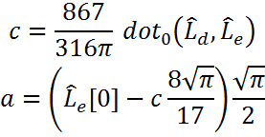
Directional + Ambient
Solve for direction after removing DC
DC is only basis function that can contribute to ambient
Given directional intensity, solve for ambient intensity
Notes:
If you also want to solve for an ambient term, SH are also handy. The ambient light source can only interact with the DC SH coefficient. So you simply solve for a directional light ignoring DC, and then use that to compute the appropriate ambient intensity.

Slide 53
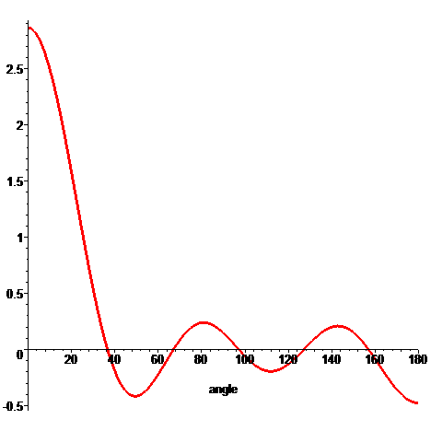
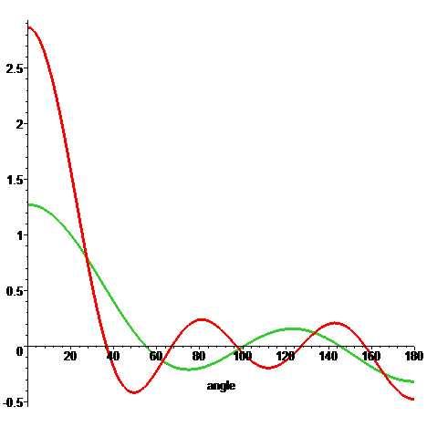
Picking Directions
“Optimal Linear” direction
Weighted “brightest” direction
SH are smooth, distinct peaks can only be so close
Look at main lobe of delta function (clear peak), generate points on the sphere so that any peak would have at least one point
Notes:
The above derivations assume you know what the best direction to use is.
One choice that works well (for a single direction) is the “optimal linear” direction, this is just the linear SH coefficients (compensating for sign), and for a lighting environment corresponds to the weighted brightest direction on the sphere.
If you want to compute multiple directions, the problem is a bit trickier. SH are always very smooth, which means that if you have a strong peak, it will be the local maxima (when climbing up the gradient) for a large angular extent.
The delta function is the strongest peak you could have, so if we look at the angular extent (really spherical area) we can just place enough points on the sphere so that any delta function would have a point that could hill climb to reach the top. The paper has more details, but you only need a small number of points to do this (22 for 6th order seems to work well.)

Slide 54
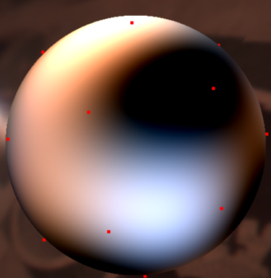
Picking Directions
Climb “up hill” from each point
Maxima f = minima –f
Keep N points that have largest value and are “far enough” (based on peak spacing) as candidates when fitting
Notes:
Here we see a lighting function with a set of uniformly distributed points (see white paper for a way to generate points). You want fo climb uphill – or find local maxima. This is the same as finding minima of –f (there are various standard algorithms to do this – I use the BFGS algorithm.)
You have all the points find local maxima, resulting in the locations on the bottom image. The peaks are going to be the points with the largest magnitude that have no other points within a fixed distance.
[click]

Slide 55
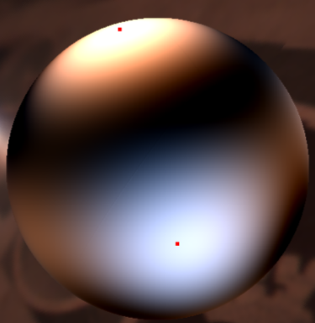
Picking Directions
Climb “up hill” from each point
Maxima f = minima –f
Solve for light intensities in given directions (see whitepaper for equations.)
Notes:
Here we see this lighting environment approximated with an ambient + 3 light sources.

Slide 56
extraction Demo
Notes:
Here we see a lighting environment and some uniform random points. These points are clumpy, so you could mix a peak. You can increase the quality of the distribution by relaxing [G][G][G] (details in whitepaper)
Now you can make the climb up hill [F][F] and you’ll see that they find the 3 dominate peaks, and some smaller ones.
You can then fit 3 lobes [D][D] {don’t left mouse!} and toggle between the approximate lighting environment and the actual one [a][a]. You can also do this toggling looking at the distorted sphere [B] [A][A]

Slide 57
Ringing

Slide 58
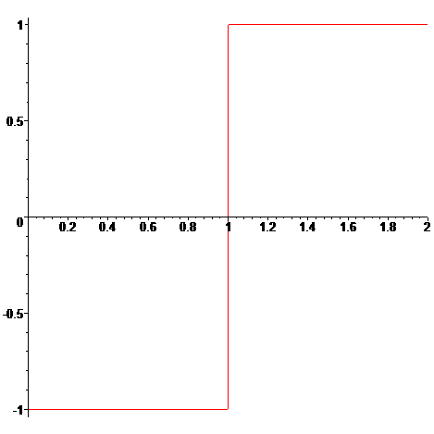
Ringing
Functions with discontinuities
Square wave
Hemisphere, visibility
Oscillations near discontinuity
No matter how many terms
Truncation also causes problem
Notes:
Functions that have discontinuities (like a square wave) can not be exactly represented with a linear combination of smooth basis functions.

Slide 59
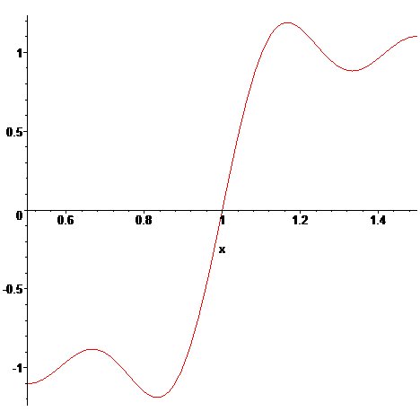
Ringing
Functions with discontinuities
Square wave
Hemisphere, visibility
Oscillations near discontinuity
No matter how many terms
Truncation also causes problem
5th degree Polynomial
Notes:
When projecting a signal with a discontinuity using the fourier basis, you will get over shoot near the discontinuity and oscillations trailing it.
Here we see part of the projection of a square wave, goes from -1 to 1 at odd integers, represented using a 5th degree polynomial.

Slide 60
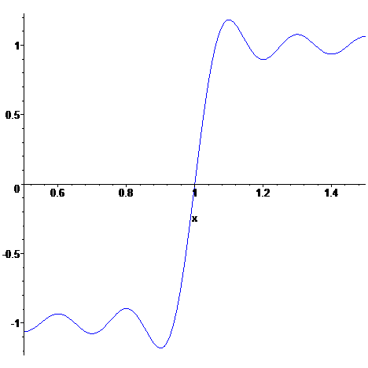
Ringing
Functions with discontinuities
Square wave
Hemisphere, visibility
Oscillations near discontinuity
No matter how many terms
Truncation also causes problem
9th degree Polynomial
Notes:
As you increase the degree, it gets closer to the square wave.

Slide 61
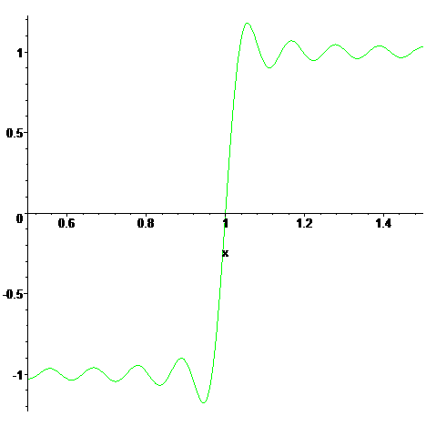
Ringing
Functions with discontinuities
Square wave
Hemisphere, visibility
Oscillations near discontinuity
No matter how many terms
Truncation also causes problem
17th degree Polynomial

Slide 62
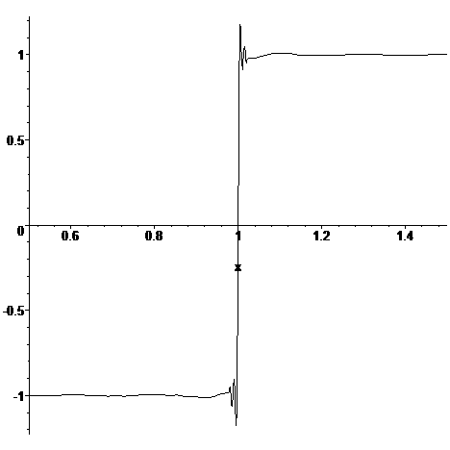
Ringing
Functions with discontinuities
Square wave
Hemisphere, visibility
Oscillations near discontinuity
No matter how many terms
Truncation also causes problem
201st degree Polynomial
Notes:
But it can never converge. There will always be overshoot and some trailing/leading oscillations.

Slide 63
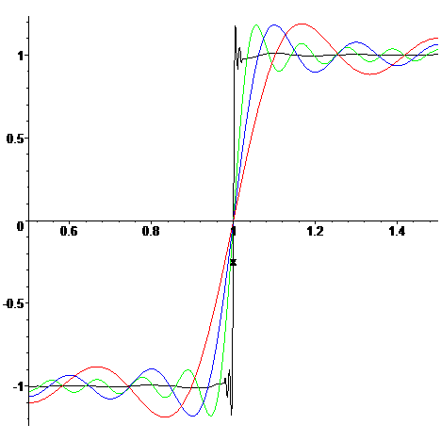
Ringing
Functions with discontinuities
Square wave
Hemisphere, visibility
Oscillations near discontinuity
No matter how many terms
Truncation also causes problem
Notes:
The amount of the overshoot is constant (around 18% of the gap for this type of discontinuity using a fourier transform).

Slide 64
Windowing/Sigma-factors
Scale the Fourier coefficients
Scale by sinc is convolution by box in the spatial domain
Raise to power
Repeated convolution with a box=bsplines
Notes:
Windowing the function in frequency space (called applying sigma factors sometimes as well) is the classic way to address this problem in signal processing.
A common window to use is a sinc function – graphed here.

Slide 65
Windowing/Sigma-factors
Scale the Fourier coefficients
Scale by sinc is convolution by box in the spatial domain
Raise to power
Repeated convolution with a box=bsplines
Notes:
It is common to take just the central lobe of the sinc show here, where it will become zero on the frequencies not used.
[click]
Since functions in the frequency domain are the fourier transform of a box function in the spatial domain. The narrower the sinc, the wider the box. In our case we have a broad sinc, which means it corresponds to a very narrow box function.

Slide 66
Windowing/Sigma-factors
Scale the Fourier coefficients
Scale by sinc is convolution by box in the spatial domain
Raise to power
Repeated convolution with a box=bsplines
Notes:
Multiplying by a stretched out sinc in the frequency domain is the same as convolving by a narrow box in the spatial domain. Which means you feed the fourier transform a function that doesn’t have discontinuities (shown here.)

Slide 67
Windowing/Sigma-factors
Scale the Fourier coefficients
Scale by sinc is convolution by box in the spatial domain
Raise to power
Repeated convolution with a box=bsplines
Notes:
The higher the freqency, the narrower the box is so the closer the function that gets projected will be to the step function.

Slide 68
Windowing/Sigma-factors
Scale the Fourier coefficients
Scale by sinc is convolution by box in the spatial domain
Raise to power
Repeated convolution with a box=bsplines
Notes:
Here we see the projection without windowing.

Slide 69
Windowing/Sigma-factors
Scale the Fourier coefficients
Scale by sinc is convolution by box in the spatial domain
Raise to power
Repeated convolution with a box=bsplines
Notes:
Here we see both the windowed and non-windowed versions. Windowing makes it much closer to the step function. It is worth pointing out that the squared error is always lowest when not windowing.

Slide 70
Windowing/Sigma-factors
Scale the Fourier coefficients
Scale by sinc is convolution by box in the spatial domain
Raise to power
Repeated convolution with a box=bsplines
Notes:
Here are the comparisons as we increase the order.

Slide 71
Windowing/Sigma-factors
Scale the Fourier coefficients
Scale by sinc is convolution by box in the spatial domain
Raise to power
Repeated convolution with a box=bsplines

Slide 72
Windowing/Sigma-factors
Scale the Fourier coefficients
Scale by sinc is convolution by box in the spatial domain
Raise to power
Repeated convolution with a box=bsplines
Notes:
At the highest order you still have a bit of error.

Slide 73
Windowing/Sigma-factors
Scale the Fourier coefficients
Scale by sinc is convolution by box in the spatial domain
Raise to power
Repeated convolution with a box=bsplines
Notes:
You can window again (multiply by sinc again), which is the same as convolving again with a box function. In the spatial domain a box convolved with a box is a tent, and this is one way of generating b-splines (repeated convolution.)
One more windowing eliminates the artifacts in this case.

Slide 74
Windowing/Sigma-factors
Scale the Fourier coefficients
Other “windows” can be used
Hanning:
Notes:
Other windowing functions can be used – the hanning window (raised cosine lobe), it attenuates higher frequencies faster than a sinc.

Slide 75
Windowing/Sigma-factors
Scale the Fourier coefficients
Other “windows” can be used
Hanning:
Notes:
But slower than the sinc squared.

Slide 76
SH Lancosz
Notes:
A free DOF that is handy to use is the extent of the window (how tight the box is), using the “idea” window tends to overly blurr the signal, giving cotnrol to trade off between ringing and blurring is useful.
Here we see windowed SH projections of delta functions.

Slide 77
SH Hanning
Notes:
This is the hanning lobe (blurrier at same width.)

Slide 78
SH Delta Function
Notes:
Here we see them graphed with the delta function (red). The un-windowed function has large negative lobes.

Slide 79
Ringing SH
Notes:
Here we see examples of ringing when rednering using PRT. The image on the left has no windowing (light source is a delta function), the bright bands are reflections from the rings. If you aggressively window (middle) you pretty much remove the rings, but the shadow is also smoothed out. A less aggressive window diminished the rings somewhat while maintaining a more defined shadow.

Slide 80
Ringing SH
Notes:
Here is an example of color artifacts that can happen. You have a white ambient light and a bright yellow directional light.
The negative lobes pull out red and green, leaving the blue color artifacts. Windowing can get rid of these artifacts.
You also have the positive lobes (order 3) and negative lobes (order 6).

Slide 81
Other Error Function
Projection minimizes squared error
HVS doesn’t…
Penalize oscillations when approximating
“curvature” – squared laplacian – easy to compute using SH
Solve for weight
Reduce curvature measure by fixed amount
Notes:
Another way to window is to change how you think about projection.
The projection equation minimizes the error function shown here – integrated squared error.
Instead you can minimize a different error function. Here is one that minimizes squared error, but also penalizes a measure of curvature (squared laplacian).
Given lambda, this can be computed in closed for as well.
You can solve for lamba by reducing the curvature by a fixed amount.

Slide 82
Other Error Function
Notes:
Here are examples reducing the curvature to 10% and 50% of the original delta function.

Slide 83
windowing Demo
Notes:
Here we see a sphere again [Z], looking at the lighting environment you can see the negative lobe [B], it’s more apparent visualizing the scalar function over the sphere [B]. If I window {drag window down} you can see it eliminate/minimize these negative lobs. [B] {fiddle with windowing} here is the distorted sphere view again.
Reducing the order doesn’t have the same effect – things get blurrier, but you don’t necessarily get rid of the negative values.

Slide 84
Content Sensitive Windowing
In graphics we don’t look at the whole function
Integrate against a somewhat compact smooth function (BRDF, possibly visibility)
Can we window only when we know we are looking “at the rings”?
Keep highlights/shadows sharp, blur rings
Applicable for lighting environments dominated by single light
Notes:
Windowing applies to the whole function. But in graphics we tend to not look at the whole function. Generally you integrate it against some smooth, but also somewhat compact, function.
If your signal has a dominant peak, you can exploit this fact to only window when the rings are going to impact the rendered result.

Slide 85
Content Sensitive Windowing
Notes:
Here we see a glossy sphere illuminated by a delta function.
The rings are clearly visible in the reflection.
Windowing blurrs out the highlight.
Content sensitive windowing keeps the highlight sharp, but blurs out the rings.

Slide 86
SH Products

Slide 87
SH Product Uses
Punch “hole” in skylight model
Large flying object
Ground plane
Big buildings
Accumulate visibility functions
Dynamic scenes
Scale light probe
Clouds
[Zhou05]
Notes:
SH products compute the product of two SH functions, and project it back to SH. Before I describe how to do them, I’m going to describe some scenarios where they can be used.
They can be used to poke “holes” in lighting environments. For example large flying objects with a skylight model, or buildings in a city. I’ve used them to zero out lights below the ground plane as well.
They have been used in several papers to accumulate visibility for dynamic scenes.
I’ll show a demo where they are used to model clouds moving under a skylight model later.

Slide 88
SH Product
Product of two SH functions projected back to SH
Can be expressed in terms of triple product tensor Γ
If f is fixed, can compute product matrix M
Notes:
The SH product is just a projection of two SH functions into SH. This involves “triple” products.
The integral of 3 SH basis functions are called the clebsch gordan coupling coefficients in the literature.
This tensor is order 3 symmetric and sparse.
If one of the functions is fixed you can build a product matrix, which can easily be computed from the function coefficients and the tensor.

Slide 89
SH Product
Product degree is sum of functions degree
Multiplying polynomials
Truncate the product
Commutes but doesn’t associate!
Accumulate at higher degree
Notes:
SH functions are polynomials, so the product will be a polynomials that has degree equal to the sum of the two functions. If you want to exactly represent the function this order grows quickly.
Instead we generally truncate the product. This has a group structure that commutes (a*b = b*a) but doesn’t associate (depends on the order), only other thing I know of that has that group structure is floating point math…
Here we have a visibility function (a lot of spheres – 48 I believe), the middle image is the SH projection, the bottom image is from using truncated products. While they aren’t exact, they are fairly close – it tends to over darken regions of heavy overlap.
[click]
Here is a 4th order projection.
[click]
If you accumulate at 6th order you get a more accurate result.

Slide 90
Special Cases
One function constant
One function analytic
Zero out ground plane
Symbolically compute
One function ZH
rotate into ZH frame, multiply, rotate back
6th order around 3x faster
Mixed orders
Output quadratic
Technique | Mul | Add
6th order | 2527 | 1995
Product Matrix | 1296 | 1260
Ground Plane | 106 | 57
ZH(*) | 380 | 249
3rd out | 933 | 676
Notes:
There are other special cases, the table on the right compares the number of multiplies and adds needed for the different variants.
A product matrix takes some work to build, but it is about half the cost of a general produt at order 6.
If one of the function is analytic (say like a hemisphere) you shouldn’t project it into SH. You can directly build an operator that computes the product. This is equivalent to having an infinite projection and can be much faster.
If one function is a ZH, you can rotate the other function to its coordinate frame, do the product (ZH has a lot of zeros) and rotate back. On a core2 this is about 3 times faster than conventional products.
You can also specialize based on the orders – for example having the output only be quadratic significantly reduces the cost (all examples in table have f and g at 6th order.)

Slide 91
product Demo
Notes:
Here we see the sphere again, now I am going to animate some “clouds” over this, we are going to be visualizing the basis functions [B][P].
There are random spheres scrolling periodically [F] above the object, we are visualizing the visibility function. There are gaps with no clouds you can see when aniamted, you can also see them if you move into the function sphere mode.
[2] now we will change to rendering an irradiance environment map.
[P] turning the clouds off, I’ll show a different lighting model [S] – this is a SH projection of the preetham model, I can change the sun angle and the skylight is based on the paper I referred to earlier. If I animate [A] this model, going from sun rise to sunset, I can then add the clouds again [P].
You can see this in the SH function view as well [B].

Slide 92
Conclusions
SH have lots of uses in interactive applications
Other investigations
Solve for windowing to eliminate/minimize negative values
Experiment with content sensitive windowing (PRT)
More aggressive optimization to pull out light sources (including area models)
Use windowing when pulling out area light sources (anneal windowing out – start with smoother function)
DX SDK:
Evaluation, Rotation, Products, Projection (cube map), Cone/Sphere lights
PRT, Irradiance Environment Map demos
Companion white paper: www.ppsloan.org/publications

Slide 93
Acknowledgments
John Snyder, Microsoft Research
Images: Jim Kajiya, Nelson Max, Stephen Spencer, Yoshinori Dobashi, Jos Stam, Ravi Ramamoorthi, Jan Kautz, Chris Oat, Kun Zhou, Ralf Habel, Manchor Ko, Hao Chen, Xinguo Liu, Tone DeRose
Co-Authors: Jan Kautz, John Snyder, Xinguo Liu, Heung-Yeung Shum, Jesse Hall, John Hart, Ben Luna, Zhong Ren, Rui Wang, Bo Sun, Hujun Bao, Qunsheng Peng, Baining Guo, Naga Govindaraju, Derek Nowrouzezahrai
Light Probes: Paul Debevec
Discussion: Hao Chen, Arn Arndt, James Grieves, Clint Hanson, Loren McQuade, Dan Baker, Alex Evans, Tom Forsyth, Willem de Boer, Machor Ko, Naty Hoffman, Chris Oat, Jason Sandlin, Jon Steed, Shanon Drone

Slide 94
Demos
What SH look like
Visualize basis functions – 3 ways?
Rotation (compare with valve)
Same code base as above
Various light models
Extracting lights
Windowing demos
Includes data dependent windowing
Product demo
Analytic skylight, have clouds zooming by
Main Demo
PRT
Visualize SH functions
Windowing
Light models
Skylight + products demo
Forked version of above?
Notes:
Demos

